Slide 1

E-Safety
Lesson 05
Cyberbullying

Slide 2


Objectives
6/7 | Evaluate situations where conflict has arisen and explore how they could have been resolved
5 | Explore how you can access help if you are ever being bullied online
4 | Explain why cyberbullying can have the same effect as being bullied ‘offline’
3 | Understand the difference between bullying and cyberbullying

Slide 3

Connect
Your friend posts a comment on social media:
Feeling sad…why won’t people just leave me alone??
What would your first action be after reading this?
What other words would you use to describe your friend’s emotions?
Why do you think your friend has posted this?
How would you support your friend? (Verbal face-to-face contact, online discussion, etc.)
Would you involve other people such as family or friends?

Slide 4
Connect
How confident are you about understanding the meaning of bullying and cyberbullying?
How confident are you at describing the impact of bullying and cyberbullying?
How confident are you at knowing how to respond appropriately to bullying and cyberbullying?
How confident are you at knowing where to seek support and advice on bullying and cyberbullying?
0
10
NOT CONFIDENT
EXTREMELY CONFIDENT

Slide 5
Activate
In small groups, consider the following questions on paper
What stressful situations occur online?
What can be the cause of online arguments?
How can we avoid or get out of conflict online?
How does cyberbullying differ from other types of bullying? Why do you think this is?

Slide 6
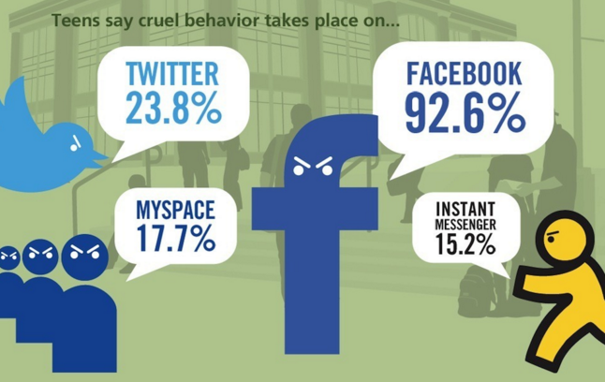
Activate

Slide 7
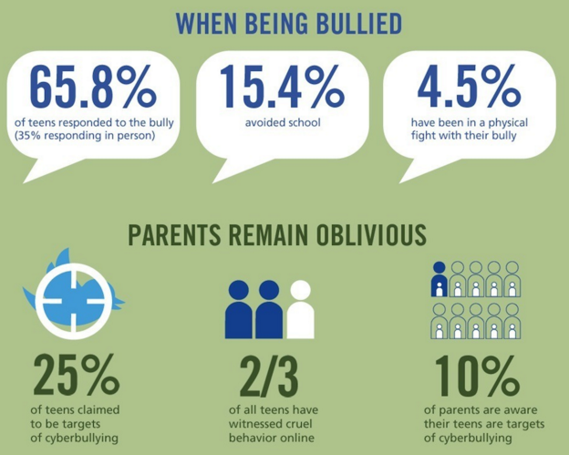
Activate

Slide 8
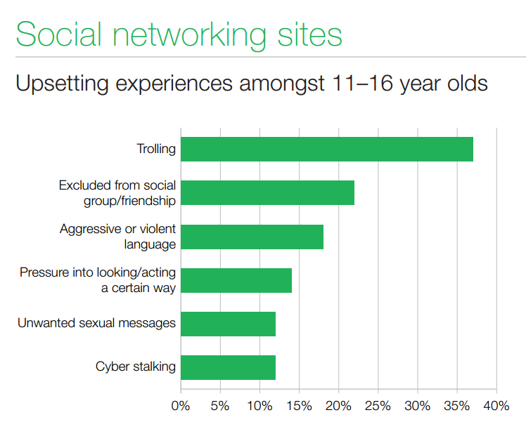
Activate

Slide 9
Demonstrate
Individual
Friends
School
Other
How could each of these groups respond to and support in resolving one of the conflicts below?
Malik has just joined the school. He sees his teacher struggling with some books and goes to help him. A group of students see this and mutter ‘freak’ under their breath at him. Every time they see him around school they shove him when they pass him.
Jade overhears her friends talking about a party they are going to at the weekend. She asks them where it is and they change the conversation and pretend to ignore her question. That weekend she sees them posting snapchats from the party saying ‘best friends forever’.
In every English lesson, students get into groups with each other for group-work. Every week, all the other students refuse to work with James, saying that he smells and is dirty. Sometimes they pass him notes with picture of a shower and tell him to ‘have a wash’.
Rhea has been friends with Martha for two years. Rhea checked her phone at break time and saw that Martha has put up a social media status about how she hates hanging out with snitches and has tagged her in it. Later that day she finds that Martha has blocked her on all the social media sites and won’t pick up her calls.

Slide 10
Consolidate
Cyberbullying is no different to bullying in real life. You don’t need to put up with it!
If someone says something that upsets you, tell someone you trust about it, such as a teacher or parent and block the bully.
Remember that typing something nasty in a message to someone is just as upsetting as saying it to their face. Think before you send!
Keep evidence to show your trusted adult. You might even need to do a screenshot.

Slide 11
Consolidate
How confident are you about understanding the meaning of bullying and cyberbullying?
How confident are you at describing the impact of bullying and cyberbullying?
How confident are you at knowing how to respond appropriately to bullying and cyberbullying?
How confident are you at knowing where to seek support and advice on bullying and cyberbullying?
0
10
NOT CONFIDENT
EXTREMELY CONFIDENT

