Slide 1

Spy School Spreadsheets
Lesson 2

Slide 2
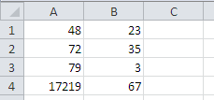
Starter
Create the following spreadsheet EXACTLY as shown, then add the formula.
A1 add B1
A2 take away B2
A3 multiplied by B3
A4 divided by B4

Slide 3
Objective of the lesson
Be able to format spreadsheets.
All of you will:
  Apply some basic formatting to a spreadsheet.
Most of you will:
  Format a spreadsheet appropriately including changing column widths, merge and centre and currency formatting.
  Use AutoFill to replicate formulae.
Some of you will:
  Add conditional formatting to a spreadsheet.

Slide 4
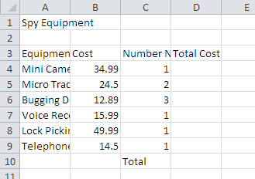
Basic Formatting
Open the Unformatted Spy Equipment from your work area.
How can this be changed to make it look better?

Slide 5
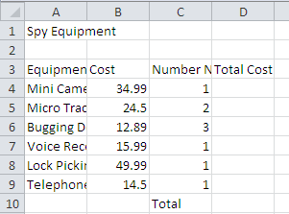
Change column widths
Click BETWEEN the column headings and drag it to the correct width.
To change the widths of the columns, move your pointer between the column headings and drag to the correct width.

Slide 6

Merge and centre the main title
Highlight cells A1 to D1 as these cells are the cells that we want to become one large cell.
Click on the Merge & Centre button.

Slide 7
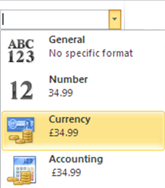
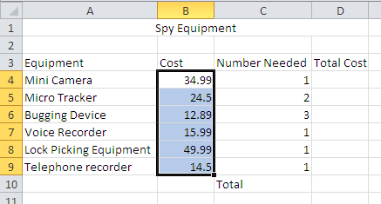
Add currency formatting
Highlight B4 to B9.
Click on the General drop down list and select Currency

Slide 8
Changing colours
Click in A1 and select the Fill Colour button
Click on the Text Colour button to change the text colour.
Change the colour of cells A3 to D3

Slide 9
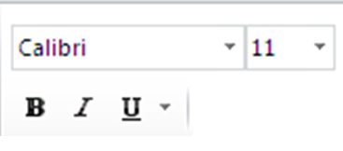
Changing font and size of text
Click on cell A1.
Change the size of the text.
Change the Font.
Bold
Italic
Underline

Slide 10
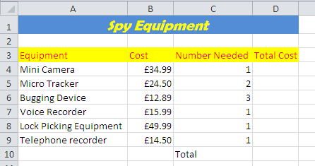
Complete the formula
Complete the spreadsheet by inserting the relevant formulae in cells D4 to D10.
B4 multiplied by C4
Add up B4 to D9

Slide 11
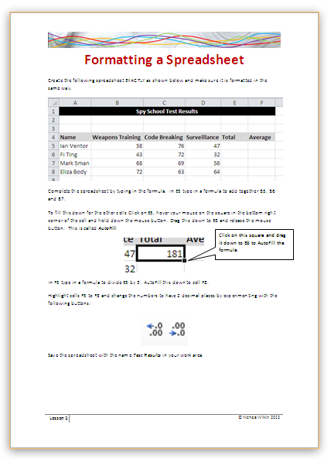
Create a new spreadsheet
Open the file ‘Formatting a Spreadsheet’ and create the spreadsheet using the data on the sheet.

Slide 12
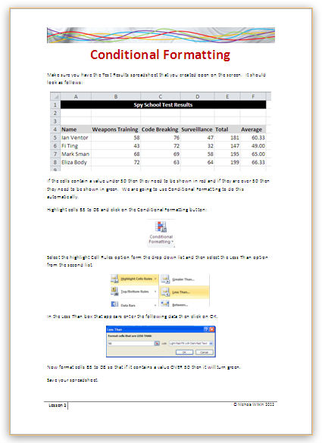
Extension Activity
Work through the handout to find out how to apply conditional formatting to a spreadsheet.

Slide 13
Plenary
You are going to be working in teams which are competing against each other.
You are going to see a number of different buttons and you need to write down what they are called.
We have already looked at most but others we haven’t looked at yet.
You are not allowed to look at a spreadsheet to find the answers.

Slide 14
Name the buttons
Bold
Fill Colour
Text Size
Border
Left Align
Top Align
Text Direction
Decrease Decimal

